Slide 1
– Senior Design –
Online Processing for Molten Salt Reactors
– Week 3 –
David Barnett, davidbb2
Nathan Glaser, nglaser3
Joseph Specht, jspecht3

Slide 2
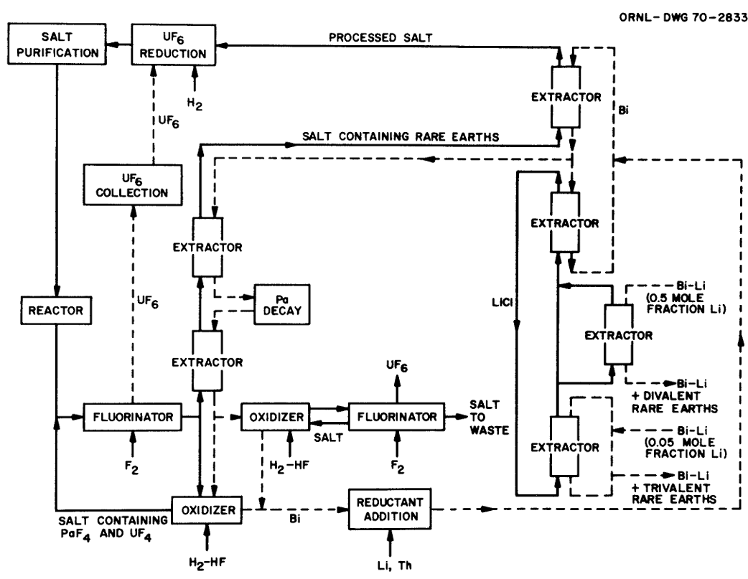
Current Ideas
Reduce pump speed
Flow diverger / siphon
Adapted helium bubbler
Tritium removal with graphene (pump speed)
MSBR Chemical Processing Flowsheet [1]
Notes:
Nathan

Slide 3
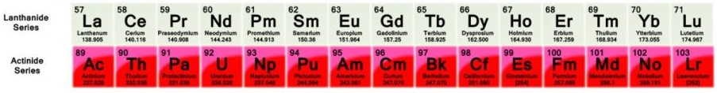
Needed Chemical Processes
Actinide separations
Lanthanide separations
Medical isotope production and separation
Sb removal / Sacrificial Lamb
Decays into Te
Te causes upper temp limit
Notes:
David

Slide 4
Potential Problems
Heat ramifications of slower flow
Hotter flow
Chemical separations in main line (too fast flow, too slow reactions, heat range)
Material limitations at high temperatures
Te
If siphon, why online? if no siphon, how?
Notes:
David

Slide 5
Meeting w/ Professor Vergari
Ratio of UF₃ / UF₄
Equilibrium concentration
Law of mass action
Check for equilibrium concentrations
Expanded cross sectional area
Slower Flow
Larger surface for rxns
Code recommendations chemical analysis
Notes:
Joe

Slide 6
0.5-D Analysis
Production in one pass
Heat
Waste
Parameter sweep
Flow speeds
Waste removal efficiency
Equilibrium waste concentration
Removal
Core
Notes:
Joe

Slide 7
Organizational Tools

Slide 8
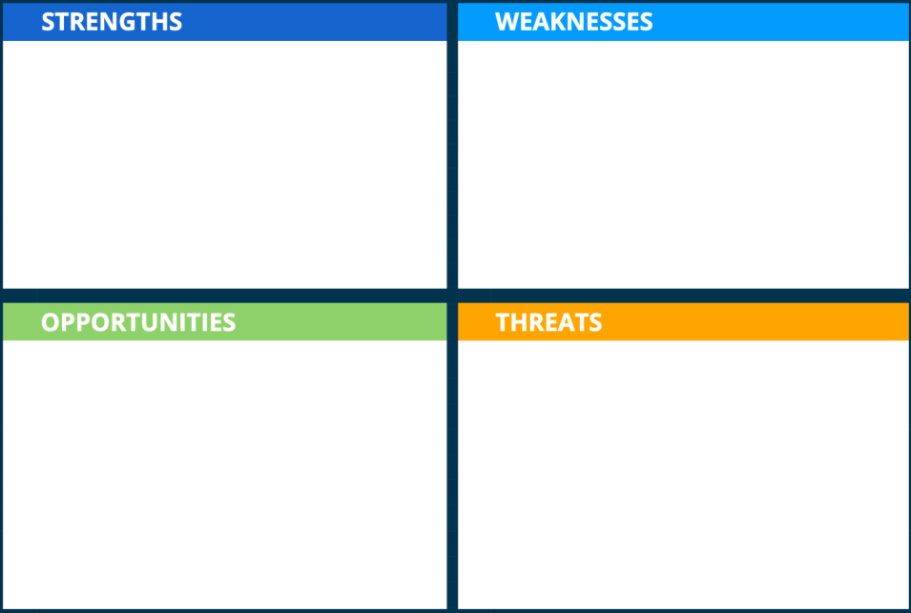
SWOT Analysis
Hesitant approach to design
Large amount of research to build off
Flexible design approach
Time consumption is great
Large amount of information will be relatively useless.
High Possibility of partial viability.
Increase in demand
Possible optics shift
Deadlines
Classified information on proposed solutions
Cost and availability shifts.
Possible optics shift
Notes:
David

Slide 9
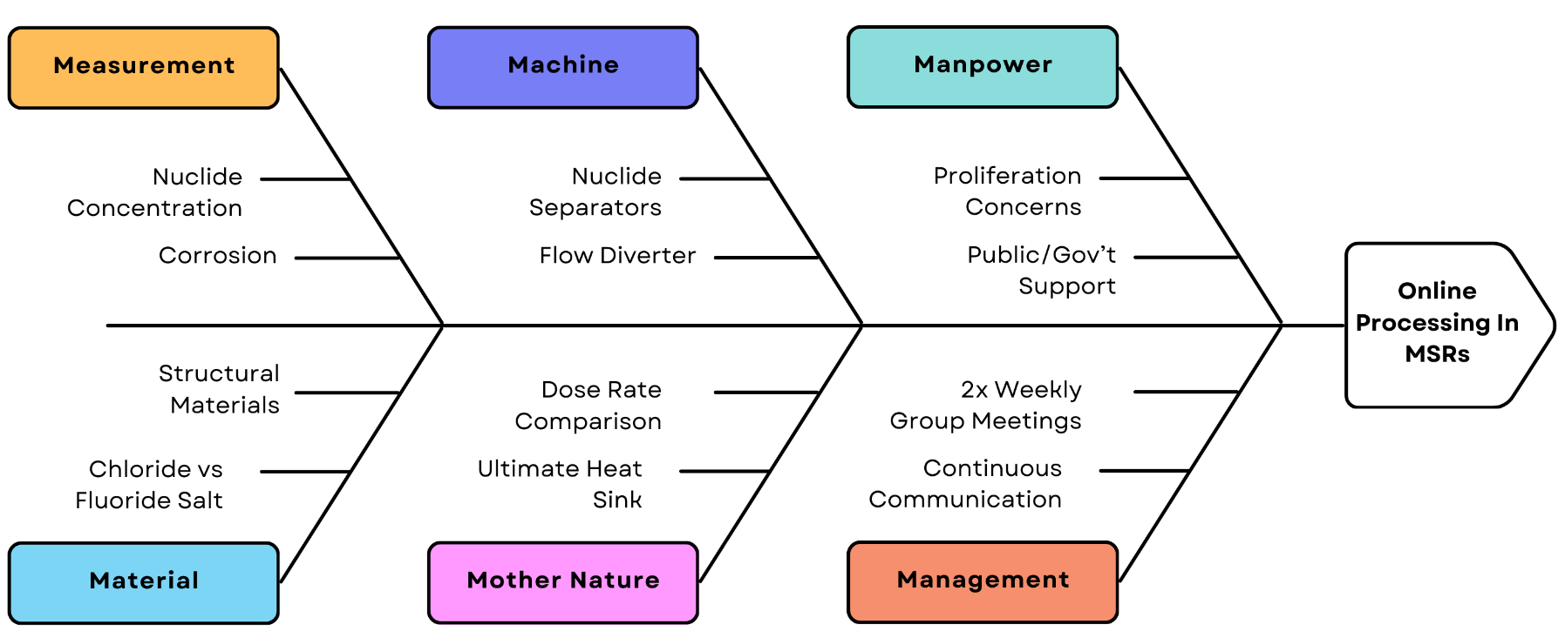
Ishikawa Diagram
Notes:
Joe

Slide 10



Organization Using Github
Notes:
Nathan

Slide 11
Thank You
Questions?

Slide 12
References
[1] Bettis, E. ORNL-TM-3832.PDF, 27 June 1972, moltensalt.org/references/static/downloads/pdf/ORNL-TM-3832.pdf.
[2] Helmenstine, Anne. “Actinides on the Periodic Table (Actinide Series or Actinoids).” Science Notes and Projects, 14 Dec. 2024, sciencenotes.org/actinides-on-the-periodic-table-actinide-series-or-actinoids/.

